Slide 1
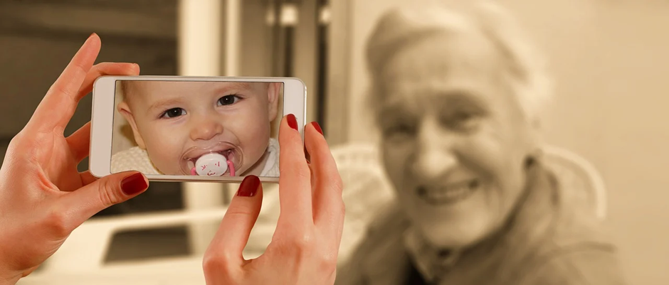
Caring from a Distance: using new and familiar means of keeping in touch with family and friends in care homes during COVID-19
Caroline White, Jane Wray, Clare Whitfield, Emma Wolverson
SPARC (Social and Psychological Research in Long Term Conditions
University of Hull

Slide 2
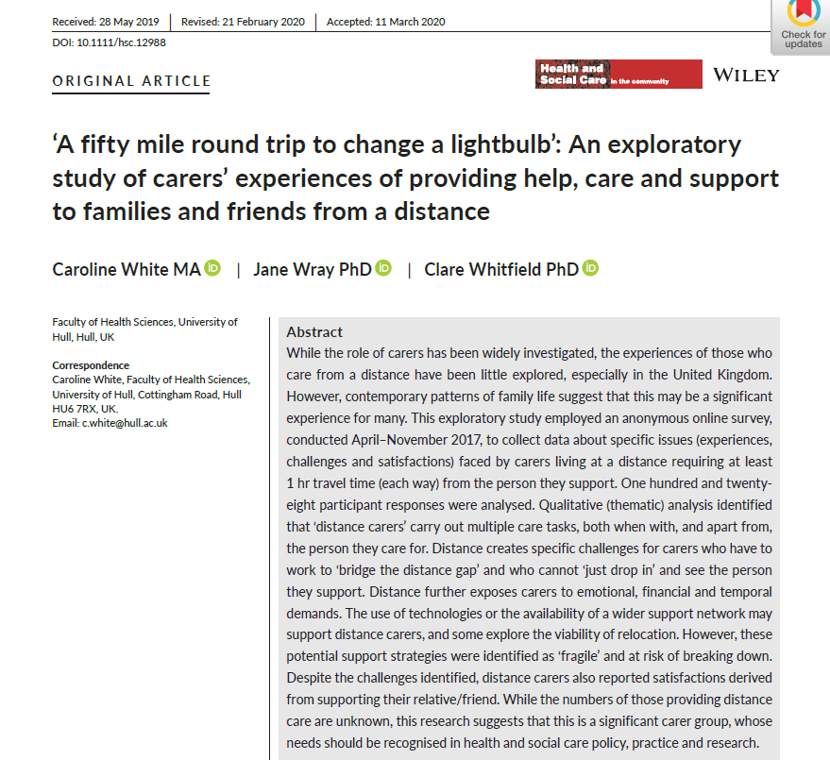
Background to the research
The needs and experiences of ‘distance carers’
Distance presents some key challenges
‘You can’t just pop in’
Distance carers need to ‘bridge the distance gap’ – travel and staying in touch from a distance
Keeping in touch can be hard between visits – people need resources and often support to use remote technologies

Slide 3
COVID-19 – everyone is now a distance carer
Care homes in the UK (& globally) closed to visitors
Family, friends, care workers need to explore new ways of keeping in touch
Opportunity to learn ‘what works’ for the future.

Slide 5
The study
Is exploring:
Have family & friends been able to keep in touch during lockdown?
How have they done this?
Have they tried new ways of being in touch?
What has worked/not worked?
Has the care home worked to support contact & how?
How has the person they support responded?

Slide 6
What we are doing?
An online survey for:
Family & friends (18+ years)
Of an adult living in a care home (or similar staffed setting)
In the UK or elsewhere
Currently ongoing
https://hull.onlinesurveys.ac.uk/caring-from-a-distance-care-home-survey
Twitter - @dist_care

Slide 7
Early responses – headline stories
Emotional impact of being unable to visit
But – majority have been able to have some form of contact (some challenges, some successes!)
Significant expansion of methods people are using to stay in touch
High proportion of care home residents have needed support to stay in touch
Important role for care staff – and good relationships matter
Over 40% of participants live at a distance of 1 hour or more

Slide 8
Thank you!
Caroline White
Jane Wray
Claire Whitfield
Emma Wolverson
https://hull.onlinesurveys.ac.uk/caring-from-a-distance-care-home-survey
@dist_care
distancecarers@hull.ac.uk

